Slide 1
Fiscal Policies for sustained and green recovery from covid-19 in pakistan
Dawn Holland
Consultant to UNESCAP/Fellow, National Institute of Economic and Social Research, UK
Policy Orientation Workshop, Sustainable Development Policy Institute
25 November 2021, Islamabad, Pakistan

Slide 2
Introduction to ESCAP Macroeconomic model for Pakistan

Slide 3
What is a macroeconomic model?
A set of interacting equations that describes key elements of the complex interactions between major macroeconomic actors and variables
Even complex models are inevitably a gross oversimplification of reality
Models will only deliver a pre-programmed response

Slide 4
the ESCAP Macroeconomic model
Developed by the Macroeconomic Policy and Analysis Section at ESCAP to support the design of economic recovery packages for countries in the Asia and Pacific region
A complete global model:
46 individual full country models for the Asia and Pacific region, including Pakistan
Smaller models of 9 key trading partners and 4 major regions
Models are linked together via trade, remittances, financial and energy markets
Runs in EViews, with most behavioural relationships specified in an error-correction framework to distinguish short-term and long-term dynamics

Slide 5
the ESCAP Macroeconomic model
What style of model?
Structural econometric model
Common theoretical structure applied to all country models
Country-specific parameters are econometrically estimated or calibrated
Designed primarily for scenario analysis rather than forecasting
Each country model has about 100 equations
Founded on a standard macroeconomic framework, with additional channels to capture key social and environmental variables
Can be applied to a wide range of policy questions plus stress testing and debt sustainability analysis

Slide 6
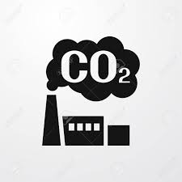
Key actors and features of the model
Households: - Consume
- Save
- Supply labour
Firms: - Produce output
- Hire labour
- Invest
Government: - Tax
- Spend
- Monetary policy
Poverty: Depends on income and post-tax inequality
Emissions: Depend on output, efficiency of production, and the energy mix
Global linkages: Via trade, remittances, financial markets, emissions and energy markets

Slide 7
Economic indicators: Modelling GDP
GDP is driven by demand in the short-term
Sum of consumption, investment, net trade:
GDP is driven by supply in the long-term
Labour, capital, energy, technology, climate damage:

Slide 8
Aggregate Demand: Private consumption
Household consumption (PCR) per capita (POPT) depends on:
Real personal disposable income (RPDI)
Financial inclusion (FINC)
Inflation ‘surprise’ (INFL – INFLe)

Slide 9
Aggregate Demand: Private Investment
Private sector investment (IPR) depends on:
Potential output (YFT)
User cost of capital (USER)
Financial inclusion (FINC)
Gross domestic income (GDI) – captures terms-of-trade shocks
Lagged dependent variable allows for persistence to capture cyclical nature of investment

Slide 10
Aggregate Demand: Public Investment and consumption
Policy variables, that are disaggregated into:
Spending on health (EXPH)
Spending on environmental protection (EXPE)
Other government consumption (OGC)
Other government investment (OGI)
Public investment cumulates onto capital stock (K)

Slide 11
Aggregate Demand: Exports
Exports (XTR) depend on:
Country-specific external demand (WDR)
Relative (non-commodity) export prices (XTDNO$/CXUD)
External demand and global export prices are derived from a global trade matrix to capture bilateral sensitivities between countries

Slide 12
Aggregate Demand: imports
Imports (MTR) depend on:
Demand (PCR+ITR+GCR+XTR)
Speed of pass-through allowed to differ across components of domestic demand
An output gap (YFT/YER)
Relative price of imported goods Oil imports

Slide 13
Aggregate Supply: Potential output
An underlying production function describes the potential output of the economy:
Capital input is determined by the accumulated investment, with a rate of depreciation that depends on global CO2 emissions
Potential labour input depends on demographics and labour force participation
$$YFT=f\left(K, L, E, T, CLIMATE\right)$$

Slide 14
Aggregate Supply: Potential output
Total energy input depends on output, energy prices and energy efficiency; the energy mix depends on relative prices of oil, gas, coal and renewables
Trend productivity growth has an endogenous relationship with health expenditure; inequality; air pollution and world trade
Climate damages are exogenous, but in scenarios can be linked to spending on climate resilient infrastructure

Slide 15
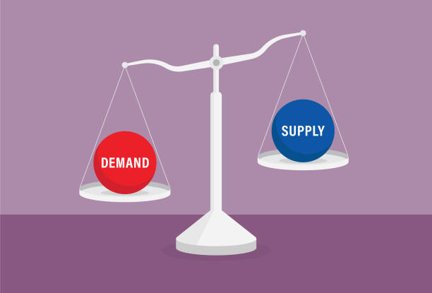
Reconciling supply and demand
Deviations of actual output from potential output set in motion adjustment processes that bring the economy back to potential in the long run.
For example, the gap between supply and demand (‘output gap’) feeds back through prices

Slide 16
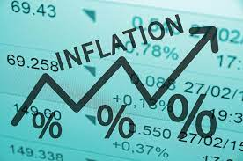
Inflation and prices
In addition to the balance of demand and supply, tax policy, global commodity prices and other imported prices determine inflation.
Higher prices:
Slows consumption
Worsens net trade balance
Both reduce GDP to bring in line with potential

Slide 17
Government sector
The model has an expanded fiscal module, to allow a range of policy scenarios to be studied
Fiscal policy channels include:
The fiscal deficit flows onto the government debt stock, and debt service payments flow back onto the fiscal balance
Spending on social protection
Spending on health
Spending on environmental protection
Fossil fuel subsidies
Carbon tax
Income tax
Corporate tax
Indirect tax
Taxes on international transactions
Commodity revenue

Slide 18
Government Borrowing premium
The fiscal deficit flows onto the government debt stock, and debt service payments flow back onto the fiscal balance
A country risk premium is linked to the ratio of government debt to GDP
Potential risks to solvency when deficit is allowed to rise
Risk premium squeezes out investment, puts pressure on the exchange rate and pushes up inflation
Deficit deteriorates
Debt rises
Risk premium rises
Debt servicing costs rise

Slide 19
Government sector
A fiscal rule can be imposed to avoid “Ponzi games”, so that debt cannot continue to rise without bounds.
When the rule is active, income and corporate tax rates rise to revert the deficit to a specified target
The rule can be turned off to assess where debt is headed if a policy package is financed fully via an increase in debt

Slide 20
Emissions and air Pollution
CO2 emissions depend on the quantity of coal, oil and gas consumed:
CO2 emissions feed into government revenue via carbon taxes and subsidies, and global emissions impact the rate of depreciation
Air pollution (PM2.5) depends on the shares of coal and oil in total energy consumption, and feeds back into trend productivity growth to reflect the relationship between pollution and health
$$CO2=96∗COALC + 57∗GASC + 67.4∗OILC$$

Slide 21
Poverty
Poverty model is based on an assumption that income approximately follows a lognormal distribution
We calculate the cumulative density function of log income, evaluated at the poverty benchmarks of $1.90/day and $5.50/day.
Requires an estimate of inequality (GINI Coefficint) and mean income (approximated to track consumption per capita)

Slide 22
inequality
The standard deviation of log income, needed to calibrate poverty, is derived from the GINI coefficient based on disposable income
The GINI depends on a relative redistribution parameter, which is linked to government spending on social protection, and a financial inclusion index, which we proxy with the share of the population with a bank account
In addition to poverty, the GINI feeds into potential output

Slide 23
ESCAP Macroeconomic model applied to illustrate policy recommendations

Slide 24
What is a scenario?
A scenario is developed relative to a baseline set of assumptions.
The scenario asks, “what if [some assumption] turns out different than assumed?”
For example, we can consider new government spending programmes, an unexpected rise in oil price, a drop in world trade, policies to encourage women to seek employment, etc…

Slide 25
Scenario 1: Increased Social Spending and Expanded Social Protection
Social protection spending (2.14% of GDP)
Fiscal balance
Real personal disposable income
Income distribution and inequality
Spending on health (5.4% of GDP)
Fiscal balance
Public consumption
Public/Private investment
Trend productivity
Spending on education (5.7% of GDP)
Public consumption
Public/Private investment
Inequality
Trend productivity
GDP
Potential output
Poverty
Government debt

Slide 26
Scenario 1: Increased Social Spending and Expanded Social Protection

Slide 27
Scenario 1: Increased Social Spending and Expanded Social Protection – Financed

Slide 28
Scenario 2: Increased female labour force participation
Rise in participation (10 percentage points over 10 years)
Potential labour input
Inequality
Unemployment rate
Potential output
GDP
Inflation
Poverty
Government debt

Slide 29
Scenario 2: Increased female labour force participation

Slide 30
Scenario 3: Invest in a Green Recovery
Eliminate fossil fuel subsidies (75%)
Fiscal balance
Energy mix
Inflation
Cost of capital
Invest in green energy (30% share of renewables)
Energy mix
Energy efficiency
Employment
Invest in green transport infrastructure (1.2% of GDP)
Emissions and pollution
Productivity
GDP
Potential output
Emissions
Government debt

Slide 31
Scenario 3: Invest in a Green Recovery

Slide 32
Scenario 4: Digital TransformatioN Universal digital access
ICT investment (2.2% of GDP)
Public investment
Private investment
Trend productivity
Financial inclusion
Potential output
Inequality
GDP
Potential output
Poverty
Government debt

Slide 33
Scenario 4: Digital transformation

Slide 34
Thank you!

