Slide 1


Policy Orientation Workshop on Fiscal Policies for Sustained and Green Recovery from COVID-19 in Pakistan
Hamza Ali Malik
Director, Macroeconomic Policy and Financing for Development Division,
ESCAP,
Bangkok, Thailand
Thursday, 25 November 2021

Slide 2
Main Messages
Economic recovery alone, currently underway in most economies, will not be sufficient to achieve SDGs … significant investments are needed in people and planet
Policymakers can improve economic growth prospects and reap notable social and environment benefits, simultaneously … ESCAP has proposed a "Build Forward Better" policy package to this end
Role of the State, and thus fiscal policy, is central to invest in SDGs and ‘Build Forward Better’ economies … need to enhance fiscal space
Several policy options are available to enhance fiscal space and generate the needed financial resources … need to align them with SDGs and climate action

Slide 3
Economic growth in Asia and the Pacific has rebounded from the worst …
Source: ESCAP, based on CEIC. Quarterly aggregates for 28 economies in AP, representing 97.4% of AP GDP. Aggregate for Q2 is based on data available for 22 countries representing 95% of GDP in ESCAP.
Notes:
Strong external demand for exports and robust manufacturing is supporting economic growth in Asia and the Pacific.
Recovery remains uneven due to varying rates of vaccination and degrees of disruption.
Output levels in most countries are still below pre-pandemic levels and far from pre-crisis trend.
Moving into 2022, the pace of recovery is likely to moderate.
Point to note: sustained economic recovery and performance will have a bearing on the availability of financial resources for SDGs.

Slide 4
… and economic growth is expected to hold up for 2021 and 2022
Source: ESCAP estimates and forecasts.
Notes:
Developing Asia-Pacific is expected to experience GDP growth of 6.8% in 2021 and 5.1% in 2022
Growth is expected to hold up in 2021 – supported by external demand, gradual resumption of activities, accelerated vaccinations
Further recovery expected in 2022 as pace of vaccination picks up, activities resume, borders reopen
Employment recovery is still slow
Inflation should remain in check, with recent price pressures to be transient

Slide 5
However, is robust economic recovery sufficient for achieving SDGs?
The pandemic has exposed inherent vulnerabilities in our economies to (economic and non-economic) shocks, leading to significant disruptions, uncertainty and loss of earlier development achievements.
A recovery in economic growth alone would not make our economies more stable, resilient, inclusive and sustainable in the long term.
We need to create economies that are more resilient to shocks, and focus on the quality of economic growth and its integration with social and green development objectives.
This will involve transforming the economies structurally to make economic growth more socially equitable and green, including through harnessing the power of digitalization for good while mitigating its negative aspects

Slide 6
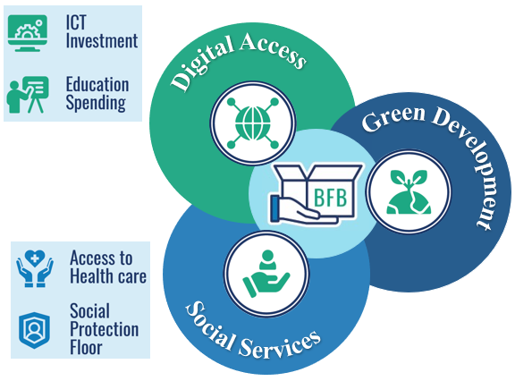
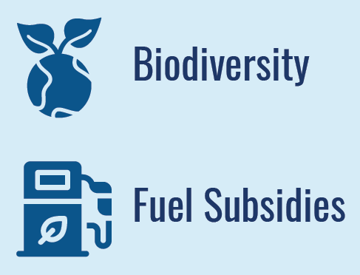
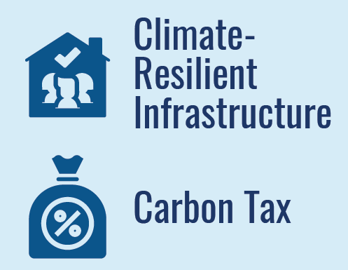

To achieve SDGs, a transformation of economies towards inclusive, resilient and green development pathways is needed
A ‘Build back forward’ policy package, proposed by ESCAP
Source: Economic and Social Survey of Asia and the Pacific 2021, ESCAP

Slide 7
Such transformation offers notable socio-economic and environmental benefits for South Asia … if ambitious investments are undertaken
Number of poor people
Gini coefficient
Carbon emissions
Air quality (PM2.5)
Ambitious investments

Slide 8
… the benefits are notably less pronounced, if ‘business-as-usual’ continues
Number of poor people
Gini coefficient
Carbon emissions
Air quality (PM2.5)
Ambitious Spending Business-as-usual spending

Slide 9
Nevertheless, implementing these ambitious policy packages will have implications for fiscal positions and public debt …
Developing Asia-Pacific
South and South-West Asia

Slide 10
How do economies finance the needed investments to ‘build forward better’, when fiscal space has been squeezed due to the pandemic?
Source: ESCAP estimates and forecasts.
Notes:
Developing Asia-Pacific is expected to experience GDP growth of 6.8% in 2021 and 5.1% in 2022
Growth is expected to hold up in 2021 – supported by external demand, gradual resumption of activities, accelerated vaccinations
Further recovery expected in 2022 as pace of vaccination picks up, activities resume, borders reopen
Employment recovery is still slow
Inflation should remain in check, with recent price pressures to be transient

Slide 11
… and to add to the challenge, current financial flows towards SDGs are small relative to SDG investment needs
Additional SDG investment needs (% of GDP per year)
Projected increase in financial flows (% of GDP )
Source: ESCAP estimates and calculations.

Slide 12
Policy options (1) to deal with the challenge of financing SDGs
Enhance fiscal space
Reprioritize public spending.
Improve public spending efficiency.
Widen the tax base.
Improve tax administration.
Increase progressivity of tax system.
Relax fiscal rules.
Reduce illicit financial flows.
Incorporate catastrophic risks into fiscal planning.
Improve debt management and develop medium-term debt strategies that include risk assessments on contingent liabilities.
Engage in debt service suspension/relief initiatives and debt restructuring discussions.

Slide 13
Policy options (2) to deal with the challenge of financing SDGs
Innovative and sustainable financing instruments and strategies
Pursue issuance of thematic bonds (green, social, sustainability, SDG-linked bonds).
Develop capital markets to leverage private investments and issue thematic bonds.
Make debt-swaps-for-development meaningful.
Explore diaspora bonds and offshore public bonds and, as host markets, relax investment rules for such bonds.
Facilitate private investments for SDGs/climate action by introducing guidelines on green investments, adopting green bank lending practices, and moving towards mandatory climate risk disclosure and reporting.
Support sustainable investing by public institutional investors (pension and sovereign wealth funds) by easing investment rules.
Consider carbon pricing – imposing a price on carbon sends financial signal that low-carbon investments have val
Increase the use of catastrophe insurances and bonds.
Develop national funds and facilities, for emergencies and for climate action.

Slide 14
Policy options (3) to deal with the challenge of financing SDGs
Promote regional cooperation
Establish a regional debt architecture to facilitate multi-stakeholder debt negotiations.
Promote shared understanding and practices.
  Common definitions and reporting standards of sustainable financing/investments.
  Frameworks and standards for thematic bonds.
  Practices and conditions for cross-border bonds, debt swaps.
Introduce/expand regional emergency funds and catastrophe risk-sharing initiatives
  Risk pooling works better with more, diverse players
Step up technical assistances
  Feasibility studies for debt swaps, thematic bonds, diaspora/off-shore bonds
  Best practices on public debt management

Slide 15
Key Takeaways
Policymakers should also focus on “reducing setbacks” (building resilience) as well as “accelerating progress” (GDP growth) to effectively pursue sustainable development … invest in people and planet.
COVID-19 pandemic offers an opportunity to rethink and transform the development pathways by ‘building forward better’ … economic policies and financing strategies should focus on social services, digital access, and green development.
Several policy options are available to enhance fiscal space and channel financial resources towards SDGs … need political will and credible commitment to the 2030 Agenda.

Slide 16
For details, see three recent ESCAP publications:
Economic and Social Survey of Asia and the Pacific 2021, ESCAP; available at: https://www.unescap.org/kp/2021/economic-and-social-survey-asia-and-pacific-2021-towards-post-covid-19-resilient-economies
ESCAP Financing for Development Series No. 4: Financing the SDGs to build back better from the COVID-19 pandemic in Asia and the Pacific 2021, ESCAP; available at: https://www.unescap.org/kp/2021/escap-financing-development-series-no-4-financing-sdgs-build-back-better-covid-19-pandemic#
Green and Climate Finance Options to Support the Post COVID-19 Pandemic Recovery and Climate Action, ESCAP and GGGI; available at: https://www.unescap.org/news/escap-and-gggi-launch-publication-aimed-mobilizing-climate-finance-achieve-net-zero
Follow us
www.unescap.org
unescap
unitednationescap
united-nations-escap
unescap
unescap

