Slide 1

Fiscal Policies for Sustainable Recovery from COVID-19: Pakistan’s Options, Constraints and Proposals
Sajid Amin Javed

Slide 2
Much has been said on impact of COVID-19 and fiscal stimulus, we, therefore mainly focus on policies for recovery from COVID-19
Three key messages:
1. Compared to financing needs, Pakistan has very limited fiscal space and traditional sources of financing may not provide the required financing.
2. Pakistan, therefore, must prioritize policy options which are most efficient, productive and that have multiplier effect. Fiscal space can be created from within the policy areas/sectors
3. Pakistan must adopt SDGs-in-all and all-in-SDGs approach to design and implement policies for recovery which has three key characteristics:
-It is inclusive
-It is green
-It is forward looking

Slide 3
A series of studies, this work, solicited by the PM office and completed in collaboration with UNESCAP, assesses:
1. The socioeconomic impacts of COVID-19 and corresponding fiscal policy responses to mitigate these impacts.
2. The sufficiency of the fiscal policy response to support the economic recovery and their alignment to the SDGs agenda of the country.
3. The fiscal needs to finance the economic recovery, in comparison with existing fiscal space to meet fiscal needs.
Based on this assessment, the study proposes possible options to enhance fiscal space in Pakistan and policy measures to align recovery to SDGs agenda of the country.

Slide 4
We aim to support the government in designing and implementing informed, evidence-based fiscal policies for economic recovery from COVID-19
Identifying set of fiscal policies which can ensure sustainable recovery from COVID-19 in Pakistan
Assessing feasibility of these policies, with a key focus on financing requirements, available fiscal space and possible options for enhancing fiscal space
Supporting the government in designing and implementing evidence-based fiscal policies to support and sustaining a fair and green recovery from COVID-19 in Pakistan.
In this way, this work aims to support and strengthen policies which are necessary to improve the socioeconomic welfare of the people.

Slide 5
We aim for a larger impact
The broader goal is to highlight and demonstrate that investments in people and environment are not an act of benevolence, they have rather a very strong economic case. And that fiscal policy vision and thinking needs to go beyond GDP growth.
Pakistan must work on identifying spending priorities, with a clear focus on people. Social spending must take priority in the broader development agenda of the country.
In this way, this work aims to support and strengthen policies supporting the agenda of putting people before the economy, where economic policies work to improve the socioeconomic welfare of the people.

Slide 6
Pakistan had a unique position when the COVID-19 pandemic hit the country, it now has the same when it comes to recovery time
1. Pakistan was going through a serious balance of payment crisis when COVID-19 crisis arrived
-economy was slowing down; GDP growth was 1.9% in 2018-19
2. Pakistan was under the IMF’s Extended Fund Facility Program, when COVID-19 hit the country. This affected fiscal policy responses, including the fiscal stimulus of the country.
3. Interestingly, Pakistan is again facing a serious balance of payment crisis, when the world is planning for a sustainable recovery.
-tight fiscal (and monetary policies) ahead.

Slide 7
Pakistan has had a lower pandemic impact level compared to other regional and global countries (top right) and trading partners

Slide 8
The impact of COVID-19 on the economy of Pakistan, though substantial, was lower than many other economies
COVID-19 caused Pakistan’s GDP growth rate to fall to -0.4%, against the pre-COVID-19 estimates of 2.2%, a contraction of 2.6%.
At the rate of 2.2% growth rate, Pakistan’s nominal GDP in 2019 was expected to increase to $321.5 billion from $314.6 billion in 2018. This however turned to $284 billion in 2019, a loss of more than $30 billion.
Three possible reason for lower impact:
The base effect (Pakistan has already touched the base; the target 2.2%; pre-covid FY, 1.9%)
2. The lower share of vulnerable trade.
-vulnerable trade Sri Lanka= 8.8% of its GDP,
-vulnerable trade Pakistan = 0.76% of GDP
3. Higher reliance on remittances, (which the COVID-19 improved, defying all expectations/models,

Slide 9
The pandemic, however, has had serious social effects, particularly on most vulnerable groups: poor, marginalized and working in informal sector, and women
-Households working in agriculture and livestock (50%);
-Wage labour, including skilled/unskilled non-agricultural laborers and forestry (22%) of total households);
-Under-five children at risk of missing out on immunization (17 million children for Pakistan);
-malnourished and stunted children (12 million); and pregnant women unable to access antenatal and postnatal care (4.7 million);
-Already food insecure population (the 40 million) and additional 2.5 million people food insecure because of Covid-19.

Slide 10
Pakistan put in place a sizeable fiscal stimulus (top panel)
It was however less than half of that required, as per UNESCAP’s estimates
.Pakistan needs another $5.3 billion to increase the fiscal stimulus from 3.1% to 5% of GDP and $10.9 billion to expand the stimulus to 7% of GDP

Slide 11
Fiscal stimulus, though less than required, significantly helped minimize the impact on poverty, unemployment
The grey bar shows “what if there was no fiscal stimulus”.
Abrupt ending of stimulus can hurt economy and people
Javed, S.A. (2021)

Slide 12
  Different measures taken under the fiscal stimulus have direct and indirect bearing upon SDGs agenda of the country take for example: transfer to low income households (top) and healthcare spending (bottom)

Slide 13
  A quick summary of policy recommendations for inclusive, green and forward looking recovery it supplements SDGs agenda of the country
1. Pakistan must increase social spending and expand social protection.
2. Pakistan must continue to push for mass vaccination policy
3. Pakistan needs to ensure balanced green funding in order to ensure transition towards green recovery energy.
4. An inclusive digital transformation is needed to achieve a resilient and future looking recovery
5. Greater gender sensitivity in fiscal policies is required

Slide 14
  Policy recommendations for inclusive recovery and associated financing needs
  1. Increasing Social Spending and Expanding Social Protection
  -Social protection (top)
  -Health
  -Education (bottom)

Slide 15
2. Pakistan needs balanced green funding in order to ensure transition towards green recovery
Financing Needs for green transportation by 2030 (USD Billion) (UNESCAP, 2021)
Private sector has greater role (bottom panel)
In other words, Pakistan need USD 3.85 billion per year to move towards green transportation

Slide 16
Policy recommendations for Resilient & Future-Looking Recovery and associated financing needs
-Inclusive Digital Transformation (top)
To achieve a universal digital access, Pakistan will require a total investment of $56.6 billion till 2030

Slide 17
Where will the money come from?
This is difficult part of the story as fiscal space from traditional sources is forecasted to remain limited

Slide 18
Where will the money come from?
The short run case!
-Reprioritizing Expenditures Can Mobilize Resources in the Short Run
This involves focusing on sectors that enhance the system’s capacity against crises, and those with higher distributional impacts, such as social protection, which reduces both poverty and unemployment.
Reprioritizing expenditures will require:
redirecting resources from low priority and unproductive areas to areas to high priority areas that are productive
spending on sectors that enhance people’s capacity to withstand the pandemic’s fallout; health and social security.
focusing on expenditures with higher distributional impacts; reducing inequalities and the gender divide.

Slide 19
Where will the money come from? The medium term
-Improving the Tax System Can Provide Fiscal Space of up to 10 Percent of the GDP
Even correcting one third of it can generate fiscal space of slightly more than USD 9 billion.
This is 1.5 times higher than EFF (2019) of IMF
Taxes are a major source of income globally and have immense potential to raise the resources needed for a post-pandemic recovery.
In Pakistan however, where the tax base remains very low, only 1 percent paid taxes in 2019 – lower than most South Asian peers (Haider, 2019).
In 2016, the country reported a ‘tax revenue gap’ of $28 billion (10 percent of its GDP) – which if reduced, can help double the tax revenue-to-GDP ratio (Javed, 2021a). To achieve this, the tax base must be expanded in a number of ways which may include:
digitalising tax processes
simplifying tax processes by introducing user-friendly ICT systems
minimizing tax evasion by strengthening anti-corruption measures and incentivizing tax collectors to raise more revenue

Slide 20
In 2019, the country paid $1.7 billion and $0.2 billion in coal and oil subsidies respectively (IEA,
2020)
-It can save 4 to 6% of GDP every year i.e., between $12.58 billion to $18.88 billion annually ($15.73 billion on average), removing transportation sector distortion.
(Sohail, et al., 2021).
Pakistan can save approximately $17.69 billion if energy sector inefficiencies are removed. (Zhang, 2019)
Reducing energy and transportation sector inefficiencies can finance green recovery

Slide 21
Where will the money come from? The long term case
-Raising Exports To 14.80 Percent of the GDP Can Bring in An Additional $19.19 Billion Annually, in the Medium to Long Run
Annual Additional Resources Available through Exports

Slide 22
Pakistan needs some innovative thinking on climate finance.
It has taken steps for recovery, keeping environmental objectives in mind
(Javed, S., A. (2021)
1. The Green Stimulus Package (2020)
  a. Expanding on the ‘10 Billion Tree Tsunami’
    *85,000 jobs so far, (115,000 additional placements expected) (WEF, 2020)
    *The World Bank also pledged $120 million this year (2021)
2. Green Euro Bond
  *WAPDA already raised USD 500 million
3. Debt for Nature’ Scheme/Debt Swaps
*Pakistan has signed/signing agreement with UK, Canada, Germany, Italy for debt swaps.
4. Ecosystem Restoration Fund (ERF)
*Launched in 2019 is umbrella program for 10 billion Tree project

Slide 23
Major challenges ahead, requiring investment in people
My colleague Dr. Dawn will demonstrate the gains from different policy measure this work has identified, with top priority of investing in people
1. Remittances may slow down (going back to average trend, even may be lower). This will worsen the current account further; pressure on rupee; inflation
2. The monetary policy is changing direction, rather it has already changed
increase in policy rate eats up gains from fiscal policy measures (Javed, S. A. 2021)
3. IMF program (short term trade off)
-limited spending options
-slow growth, higher inflation
One immediate relief to the marginalized and poor can be targeted subsidies using NSER.
In medium term; Pakistan needs to move towards universal social protection.
In the long run, investments in health, education, skills development will be key to create a resilient economy.

Slide 24
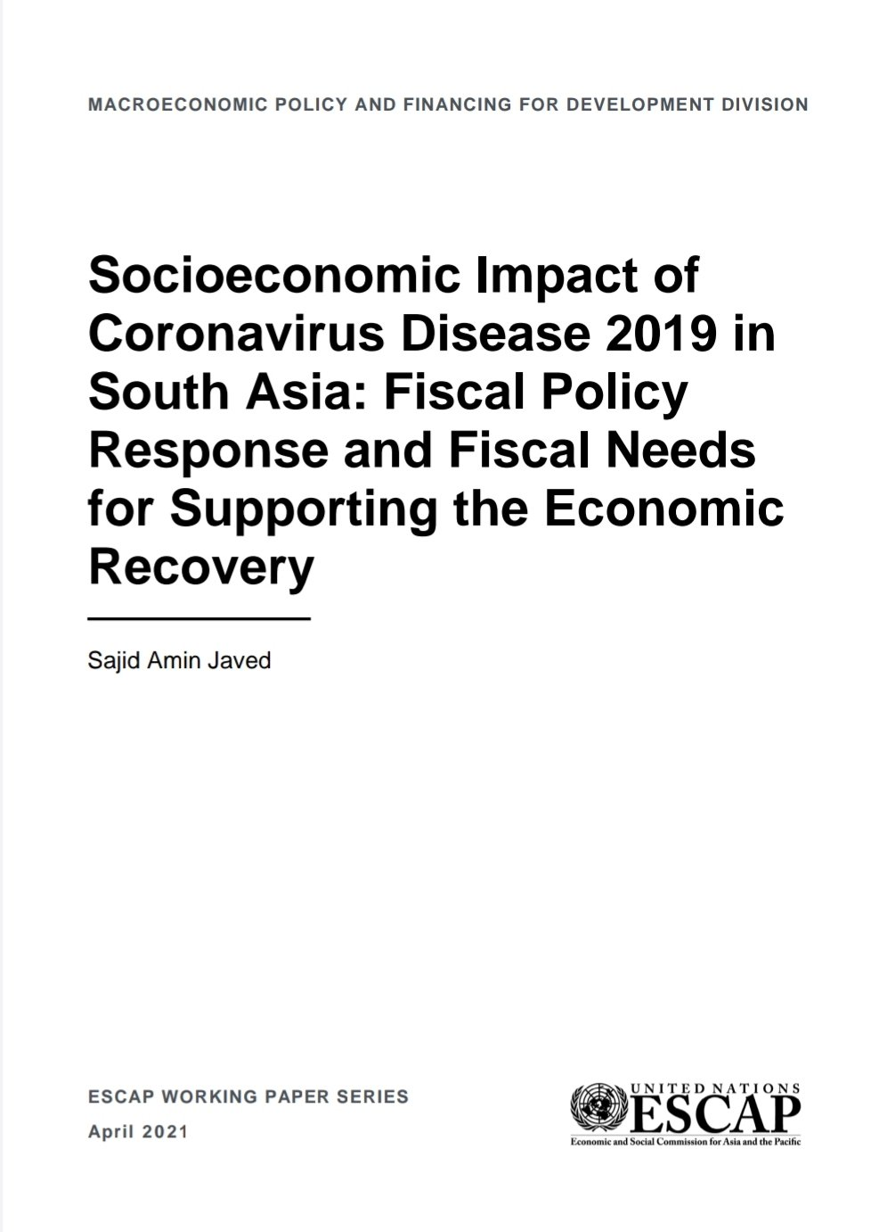
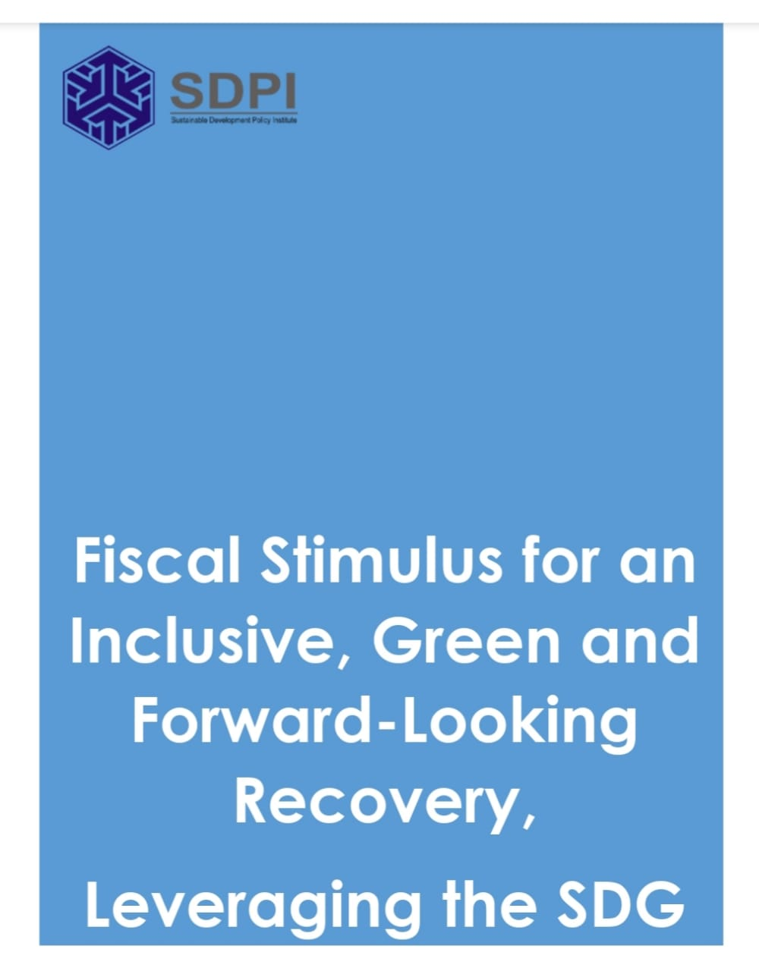
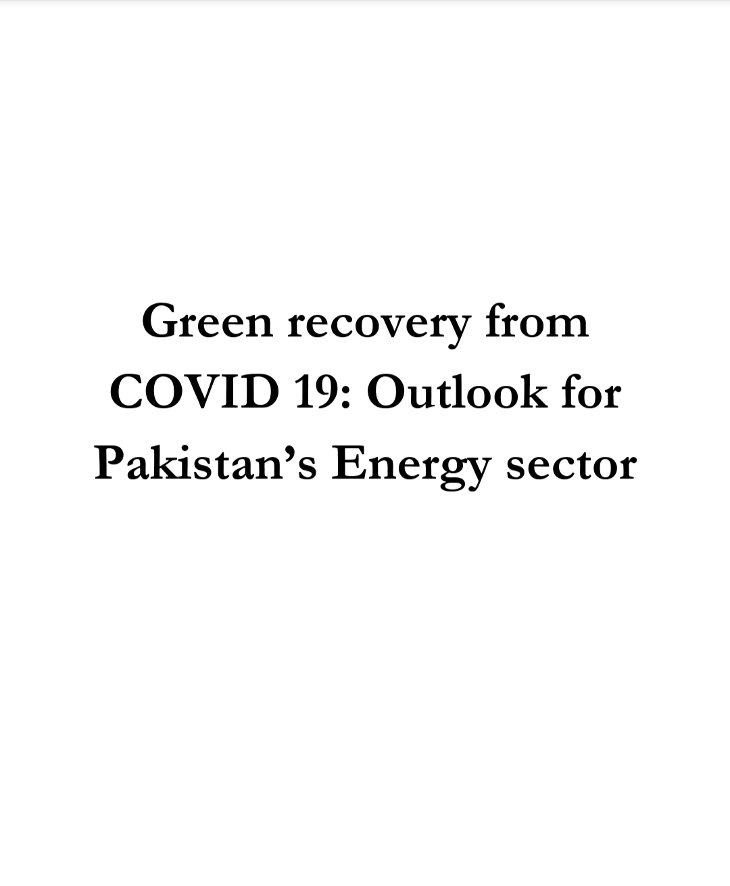
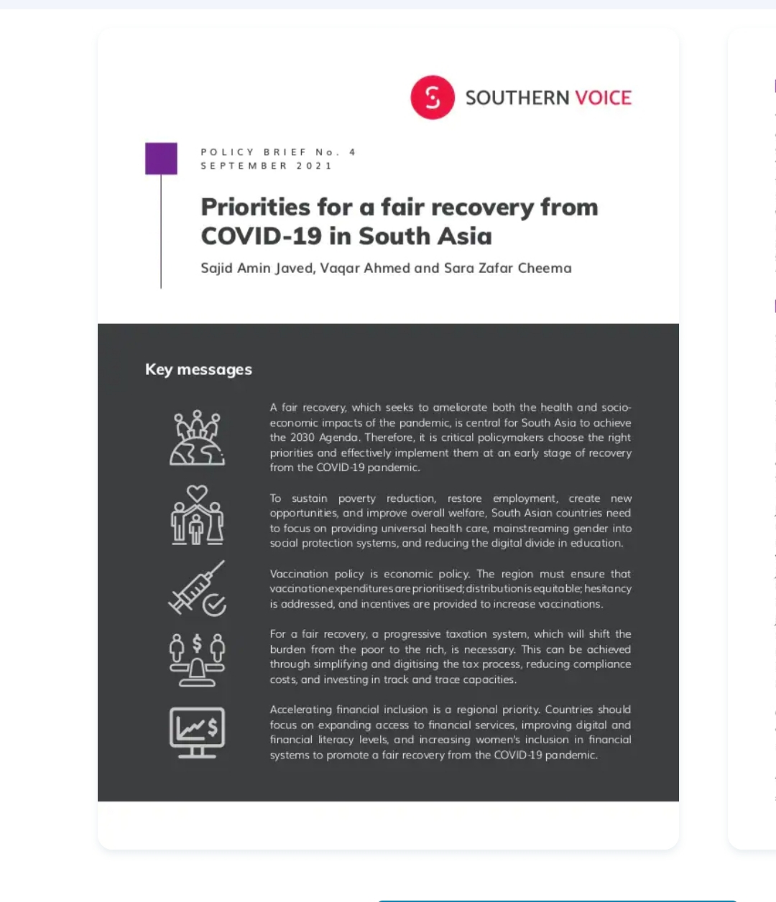
Thanks!
Here is some of our recent work on economic recovery
Debt Swaps for Sustainable Recovery from Covid-19

